Slide 1
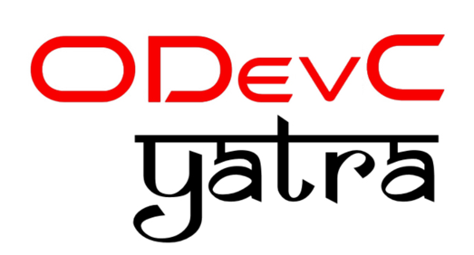
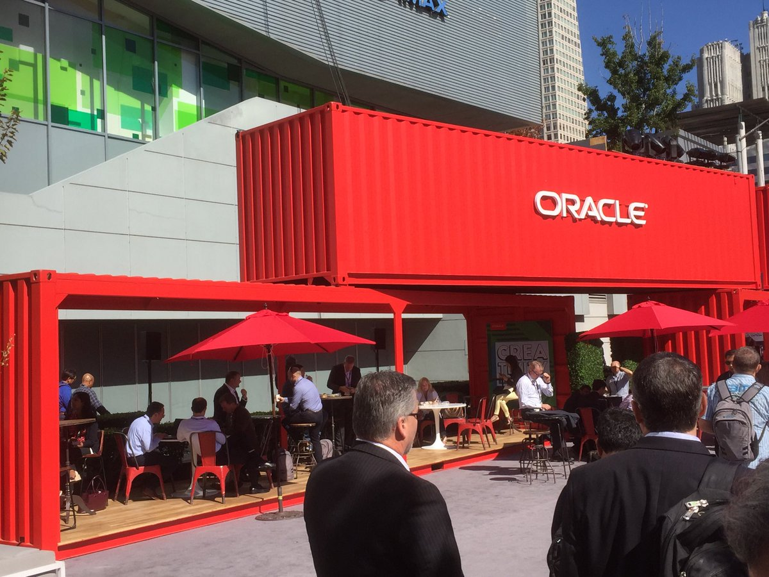

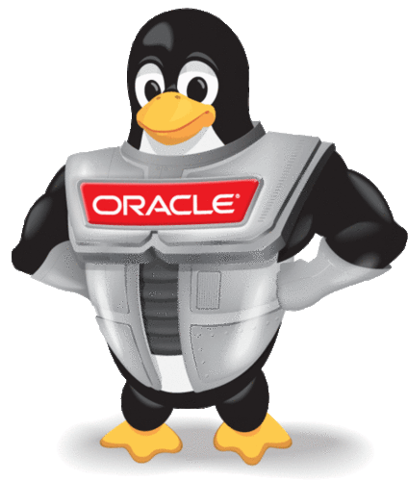
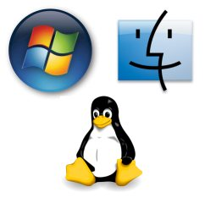
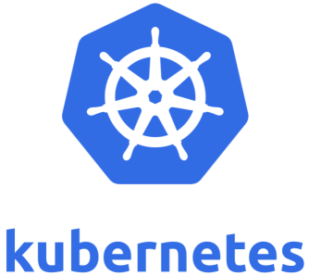
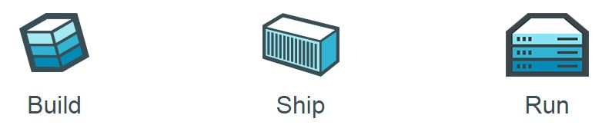
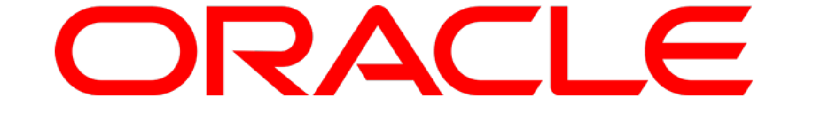
and the Oracle Platform - Database, WebLogic & the Cloud
Intro to Docker Containers
Lucas Jellema, CTO of AMIS
ODevC Yatra, Pune, Friday 13th July 2018
Notes:
Session structure Introduce Containers - objectives, benefits, implementation Demo of Container build, package, ship and run
Discuss Container Management systems - run time Container platforms, such as Oracle Container Cloud
Demo of deploying and running a Container first locally
then on the Oracle Container Cloud
Discussion of CD, DevOps and microservices - and how the Orace platform components fit in
(including a discussion of multitenant architecture in DB and WLS)
Introduction of Oracle Docker Images
Demonstration of building containers based on Oracle Docker Images
Run multiple containers based on various Oracle Docker Images and have them interact with each other

Slide 2

Lucas Jellema Architect / Developer 1994 started in IT at Oracle 2002 joined AMIS Currently CTO & Solution Architect

Slide 3

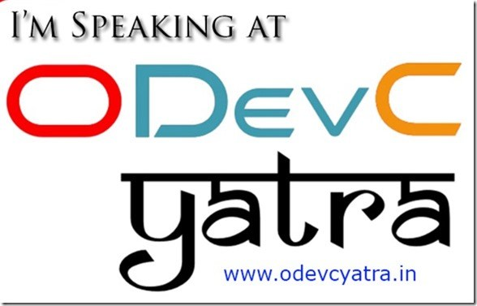
Presenting
Oracle OpenWorld
JavaOne
Oracle Code
Devoxx
Java and Oracle User Group meetups
JavaOne Rockstar (JavaOne 2015)
ODevC Yatra 2018

Slide 4
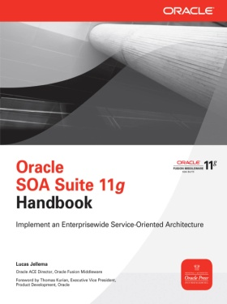
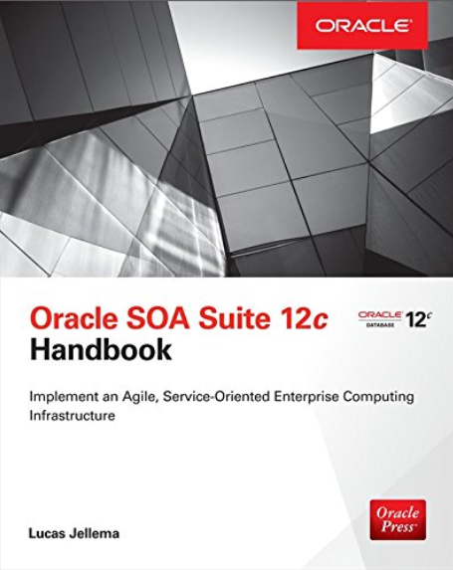


Writing
Blogs at http://technology.amis.nl
1500 articles – from UI to Middle Tier, Database and Infrastructure
Articles at Medium, DZone and Oracle Technology Network
Books for McGraw Hill (Oracle Press)
Oracle ACE Director & Developer Champion

Slide 5
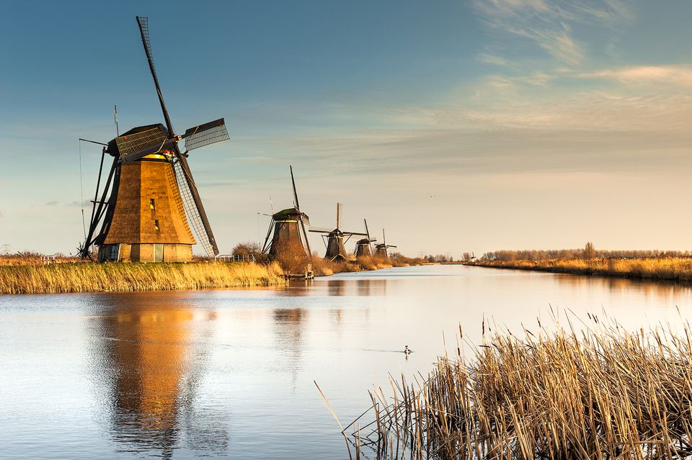
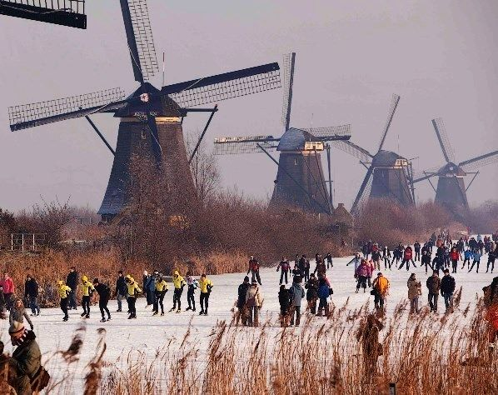
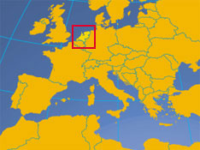
From The Netherlands

Slide 6
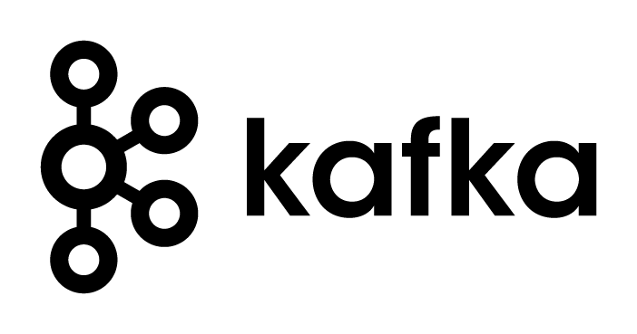
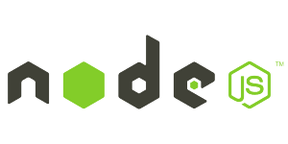
Setup for Oracle OpenWorld Demo What I needed
Local installation of a Kafka Cluster
At least one Broker node and the Zookeeper
Demo Application
Kafka Broker
Zookeeper

Slide 7
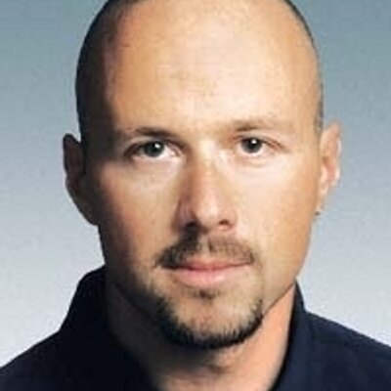
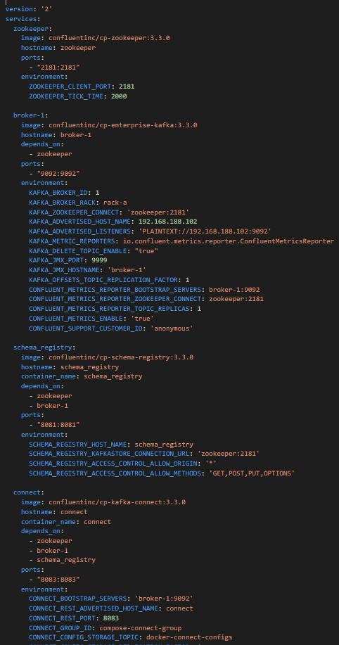
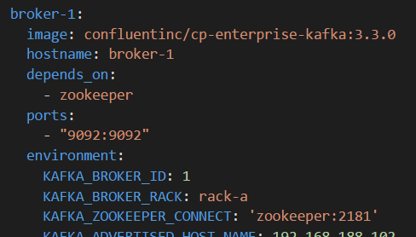
Setup for Oracle OpenWorld Demo What I received from Guido
Simple text file – 140 lines
Name of Docker image to run
Hostname on internal network between Docker containers
Dependency on other container (to start first)
Container port to expose externally
Environment variable to pass to container

Slide 8
Setup for Oracle OpenWorld Demo What I created in a few minutes
9092
Kafka Broker
8084
2181
Kafka
Rest Proxy
Zookeeper
8081
Kafka
Schema Registry
8083
8001
Kafka
Connect
Kafka Connect UI
9000
8002
Kafka Manager
Kafka
Schema Registry UI

Slide 9

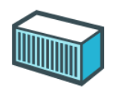
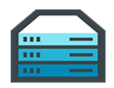
Some Quick Conclusions
Docker provides a great way to
Build environments (application & platform) (from simple, text based build files & public images)
Share & Ship these environments (either through build files or through ready-to-run images)
Run environments making efficient use of physical resources (that can be complex and have complex interdependencies)
And Guido is a very nice guy
And also:
[Docker] Containers are pivotal in cloud native environments, microservices architecture, DevOps and CD
Any IT professional should know her or his way around containers

Slide 10

Overview of today’s session
Docker Container – what and why?
Build, ship, run & operate
Use in development, training, testing, delivery and production & operations
Running custom containers on Oracle Container Cloud
Microservices and the application platform of tomorrow
Introducing Kubernetes and the upcoming Oracle Kubernetes Engine Cloud
Building Containers with Oracle platform from Oracle GitHub repo
Oracle Container Registry with prebaked images for Oracle platform
Going forward…

Slide 11
Linux essentials
Applications share resources
Memory
Network interface
IP address
Ports
Users & groups
Environment Variables
Packages
Services
Application A
CPUs
Application B
Application C
Disk Storage

Slide 12
Linux essentials: Control Groups and Namespaces
Compartmentalize Resources into isolated units
Memory
Network interface
IP address
Ports
Users & groups
Environment Variables
Packages
Services
Network interface
IP address
Ports
Users & groups
Environment Variables
Packages
Services
Network interface
IP address
Ports
Users & groups
Environment Variables
Packages
Services
CPUs
Network interface
IP address
Ports
Users & groups
Environment Variables
Packages
Services
Network interface
IP address
Ports
Users & groups
Environment Variables
Packages
Services
Disk Storage

Slide 13
Linux essentials: Control Groups and Namespaces
Expose units through mapped network ports
Memory
Network interface
IP address
Ports
Users & groups
Environment Variables
Packages
Services
Network interface
IP address
Ports
Users & groups
Environment Variables
Packages
Services
Network interface
IP address
Ports
Users & groups
Environment Variables
Packages
Services
CPUs
Network interface
IP address
Ports
Users & groups
Environment Variables
Packages
Services
Network interface
IP address
Ports
Users & groups
Environment Variables
Packages
Services
Disk Storage

Slide 14


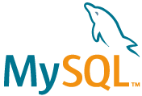
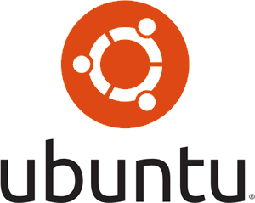
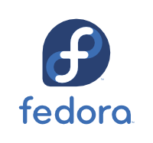
Linux essentials: Each unit runs its own processes
Units run their own processes:
OS (Linux)
Platform
Application
Memory
Network interface
IP address
Ports
Users & groups
Environment Variables
Packages
Services
Application A
Network interface
IP address
Ports
Users & groups
Environment Variables
Packages
Services
Application B
CPUs
Network interface
IP address
Ports
Users & groups
Environment Variables
Packages
Services
Application C
Network interface
IP address
Ports
Users & groups
Environment Variables
Packages
Services
Network interface
IP address
Ports
Users & groups
Environment Variables
Packages
Services
Disk Storage

Slide 15

This stuff is complex
Core Linux features were hard to use
Memory
Network interface
IP address
Ports
Users & groups
Environment Variables
Packages
Services
Application A
Network interface
IP address
Ports
Users & groups
Environment Variables
Packages
Services
Application B
CPUs
Network interface
IP address
Ports
Users & groups
Environment Variables
Packages
Services
Application C
Network interface
IP address
Ports
Users & groups
Environment Variables
Packages
Services
Network interface
IP address
Ports
Users & groups
Environment Variables
Packages
Services
Disk Storage

Slide 16
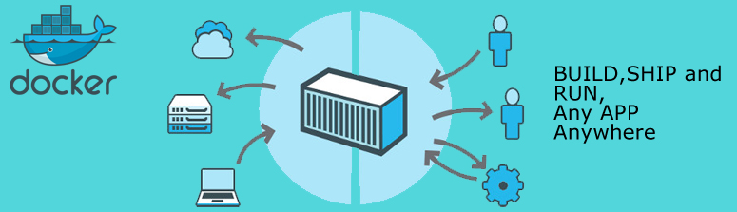
Docker has democratized Linux Containers
Container Image – a serialized file from which we can instantiate a container
Container Build script and workflow – to automate the creation of a container (image) using straightforward vocabulary
Engine – runtime platform for instantiating, running and managing containers, volumes and networks (REST API and CLI)
Docker Registry – Repository for Container Images
And now also Docker Store
Memory
Network interface
IP address
Ports
Users & groups
Environment Variables
Packages
Services
Application A
Network interface
IP address
Ports
Users & groups
Environment Variables
Packages
Services
Application B
CPUs
Network interface
IP address
Ports
Users & groups
Environment Variables
Packages
Services
Application C
Network interface
IP address
Ports
Users & groups
Environment Variables
Packages
Services
Network interface
IP address
Ports
Users & groups
Environment Variables
Packages
Services
Disk Storage

Slide 17


Running Containers using Docker
Docker Hub
Create Container(s) from Image plus:
Port mapping
Volume
Environment Variable
(inter container) Network
Startup script
Container images
Memory
Network interface
IP address
Ports
Users & groups
Environment Variables
Packages
Services
Application A
Network interface
IP address
Ports
Users & groups
Environment Variables
Packages
Services
Application B
CPUs
Application C
Network interface
IP address
Ports
Users & groups
Environment Variables
Packages
Services
Network interface
IP address
Ports
Users & groups
Environment Variables
Packages
Services
Docker Engine
Disk Storage

Slide 18
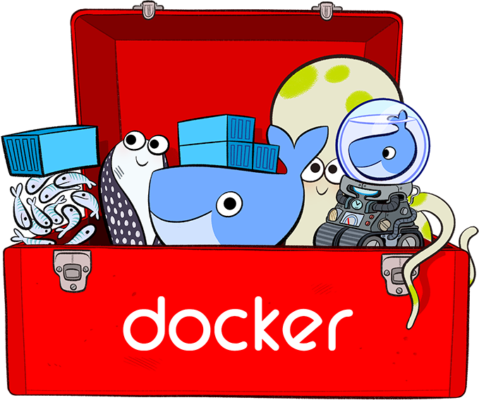

Running Containers using Docker on Windows
Docker is a Linux mechanism
In order to run on a Windows server, we use a Linux VM
VirtualBox
Hyper-V
…
Docker Toolbox
It is possible to run the Docker Engine inside a Docker Container
Docker Container inside Docker Container [inside VM]
Memory
Network interface
IP address
Ports
Users & groups
Environment Variables
Packages
Services
Application A
Network interface
IP address
Ports
Users & groups
Environment Variables
Packages
Services
Application B
CPUs
Network interface
IP address
Ports
Users & groups
Environment Variables
Packages
Services
Application C
Network interface
IP address
Ports
Users & groups
Environment Variables
Packages
Services
Network interface
IP address
Ports
Users & groups
Environment Variables
Packages
Services
Disk Storage

Slide 19
Run container image on Docker host
Running Docker Containers

Slide 20
Running Containers using Docker
Docker Hub
Application A
docker run
--name ApplicationA
amis/NodeAppRunnerImage:latest
/bin/bash
amis/NodeAppRunnerImage:1.4
Application A
ApplicationA
Docker Engine

Slide 21
Running Containers using Docker
Docker Hub
Application A
docker run
--name ApplicationA
-p 8010:8080 -p 8011:1521
--network=myBridgeNW
-e APP_HOME=/home/apps/applicationA -e PARAM1=value1
amis/NodeAppRunnerImage:latest
/bin/bash
amis/NodeAppRunnerImage:1.4
8010
8080
8011
1521
Application A
APP_HOME= /home/apps/applicationA
ApplicationA
PARAM1=value1
Docker Engine

Slide 22
Running Containers using Docker
Docker Hub
Application A
docker run
--name ApplicationA
-p 8010:8080 -p 8011:1521
--network=myBridgeNW
-v /hostworkdir
-v /tmp/files:/host_files
--volumes-from dataContainer
-e APP_HOME=/home/apps/applicationA -e PARAM1=value1
amis/NodeAppRunnerImage:latest
/bin/bash
amis/NodeAppRunnerImage:1.4
8010
8080
8011
1521
Application A
APP_HOME= /home/apps/applicationA
ApplicationA
PARAM1=value1
dataContainer
Docker Engine
Disk Storage
/host_files
/data

Slide 23
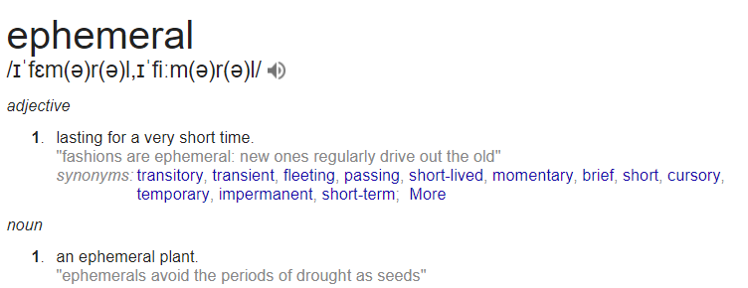
Containers are ephemeral (*
(* Candidate for IT word of the year 2018

Slide 24
Container state that needs to survive should be on an externally mapped volume
/data
-v /data:/u01/app/data
--mount source=/u01,target= /u01/app/data
Host Disk Volume
/u01/app/data

Slide 25
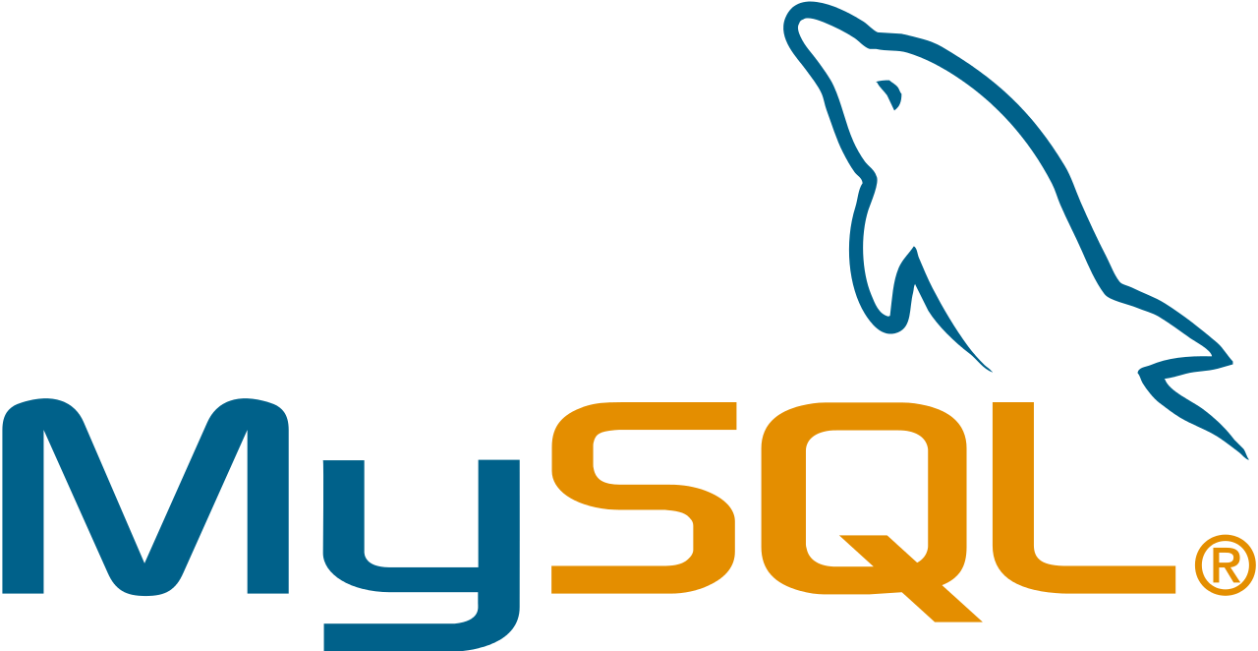

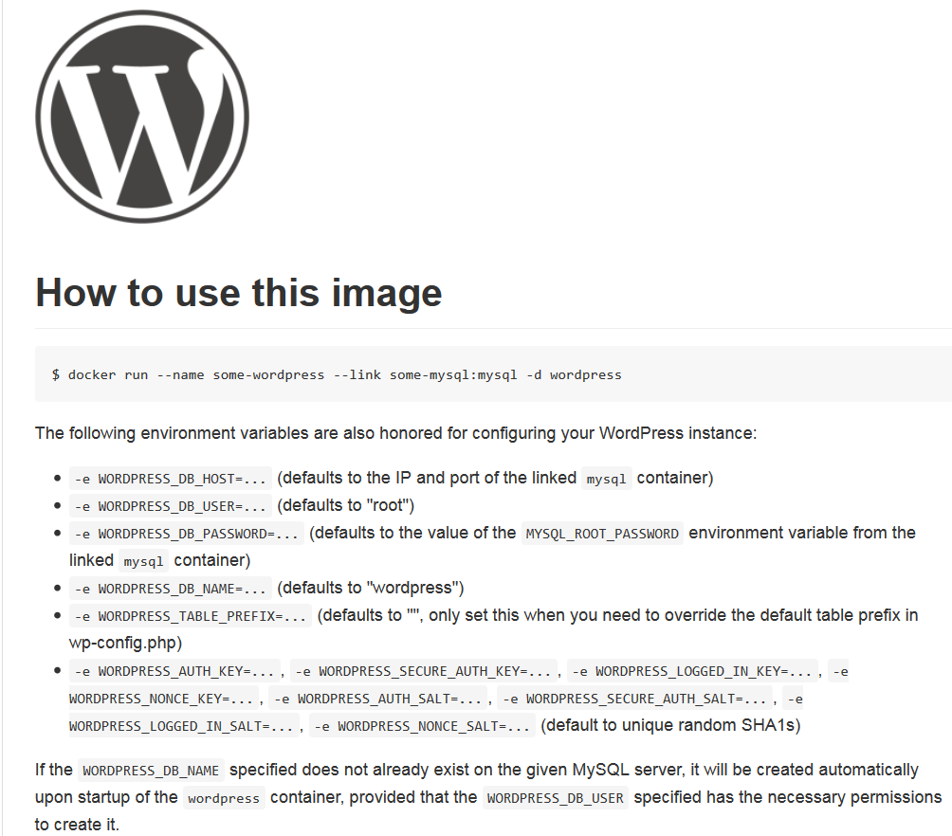
Implicit Docker Container Image Interface: environment variables, ports, volumes
Docker Hub
Parameters:
WORDPRESS_DB_PASSWORD, WORDPRESS_DB_USER, …
link mysql
Parameters:
MYSQL_DATABASE, MYSQL_ROOT_PASSWORD
Volume
..:/var/lib /mysql

Slide 26
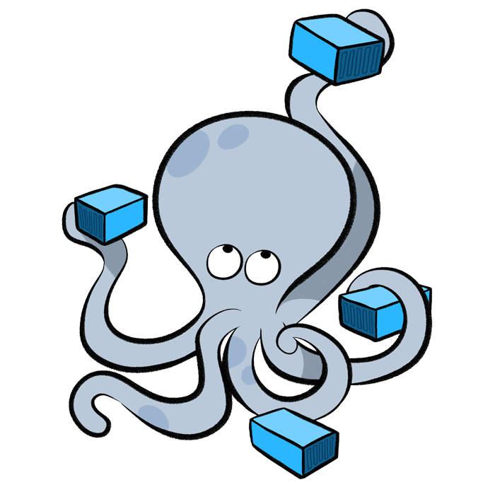
Running and Managing Containers
Start | Pause | Stop | Delete | Export | Import containers
Save | Load Images
List containers | images | networks | …
Inspect container
Run multiple instances of an image
Execute into running container
Attach to (standard input | output | error stream of) running container
Get Container Logs
Create Network
Connect container to network
Experimental feature: Snapshot (CRIU)

Slide 27
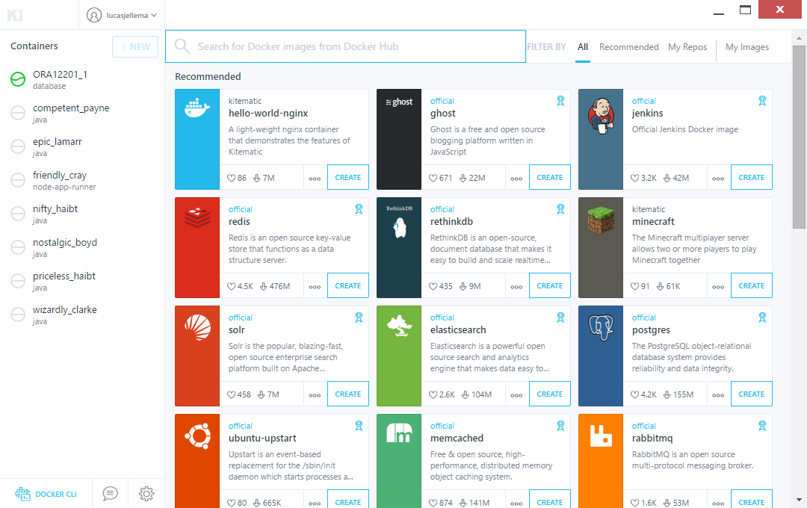
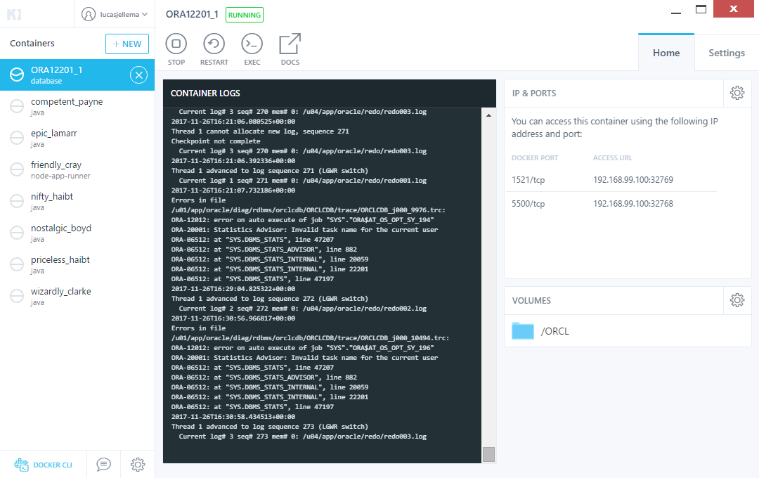
GUI tools for Managing Docker Runtime
Kitematic
Portainer.io
Simple Docker UI
Dockstation
Shipyard
MicroBadger
Foxy
Notes:
https://github.com/davidholiday/foxy
https://blog.codeship.com/docker-guis/

Slide 28
Create a runnable Docker Container image
Building Docker Container Images

Slide 29
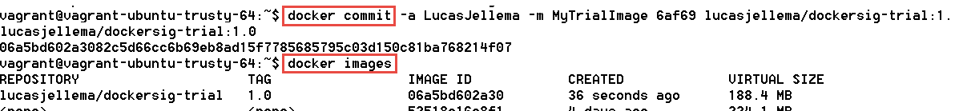
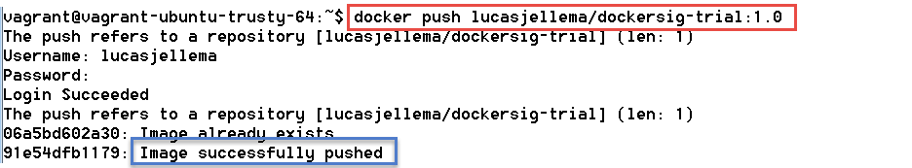
Building container images
Docker Hub
Dockersig-trial:1.0
Manual:
Run a container
Perform all installation and configuration
Commit the container and tag as new Container Image
Push Image to Registry to reuse

Slide 30

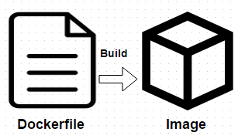
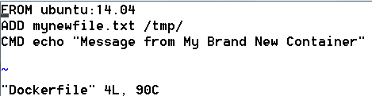
Building container images
Docker Hub
Dockersig-trial:1.0
Scripted (automated & repeatable/evolvable):
Create Docker Build file
Select base image
Gather files required during build
Consider multistage build
To purge intermediate artifacts
Build and Commit Image
Commit build file to Git
Push Image to Registry

Slide 31
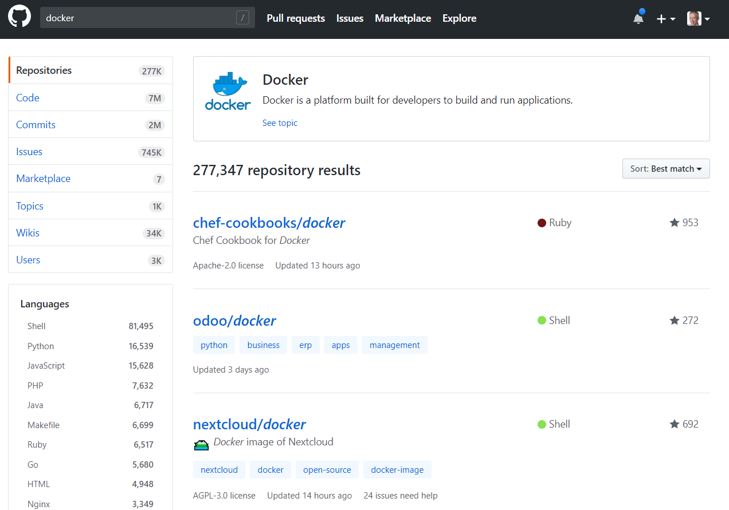
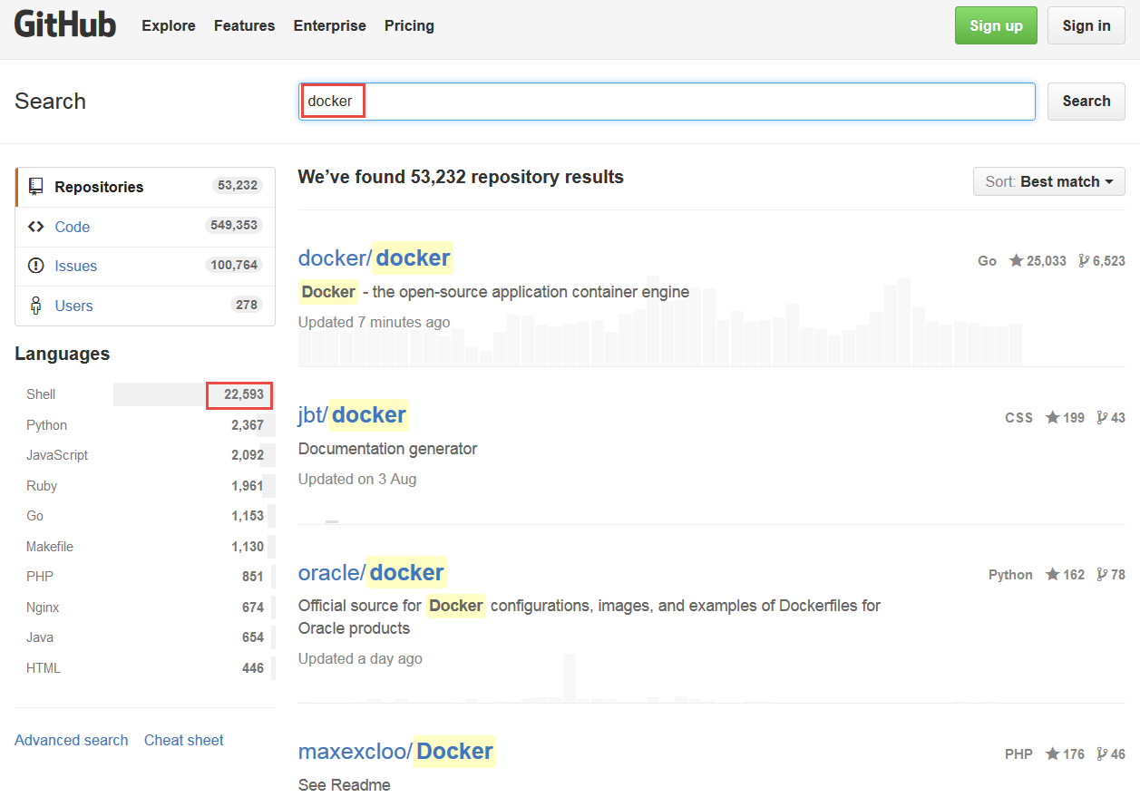
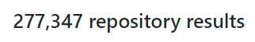
Docker Build Files on GitHub
Summer 2018

Slide 32

Distribute Docker Container images using Container Registry and more
Shipping Docker Container Images

Slide 33

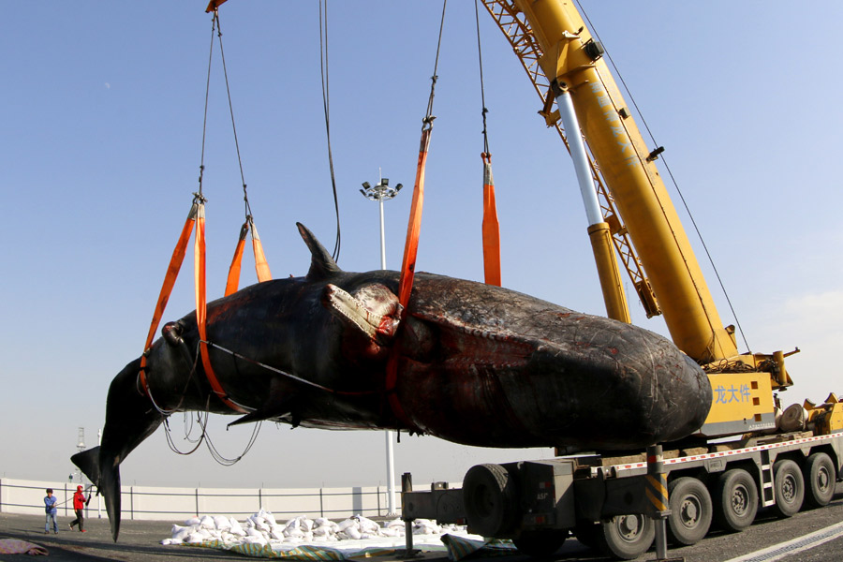
Do not share container image – share container build file!

Slide 34
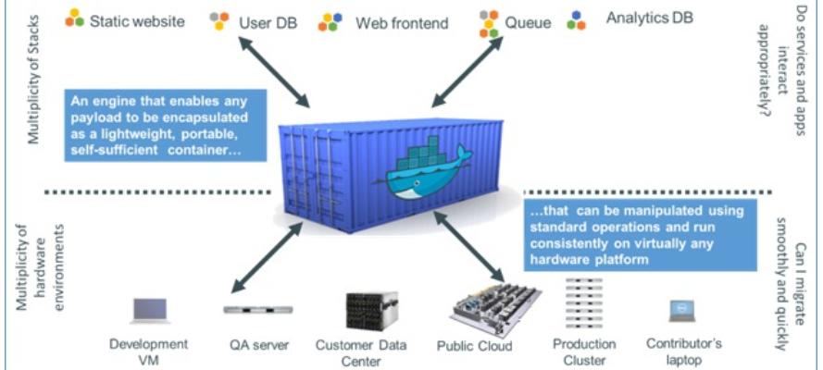
Ship (Container Images)
Package, Distribute, Share, Publish and Consume container images
The frozen state of a container (committed after building and further manipulating)
With everything needed to run the micro service: application and underlying platform & OS, ready to run on any Docker Engine anywhere
With an implicit interface (environment variables, ports, volume)

Slide 35
Docker Image Registry
Public Docker Registry
Docker Hub
push
pull &run
Private Docker Registry
Docker Hub
push
pull &run

Slide 36
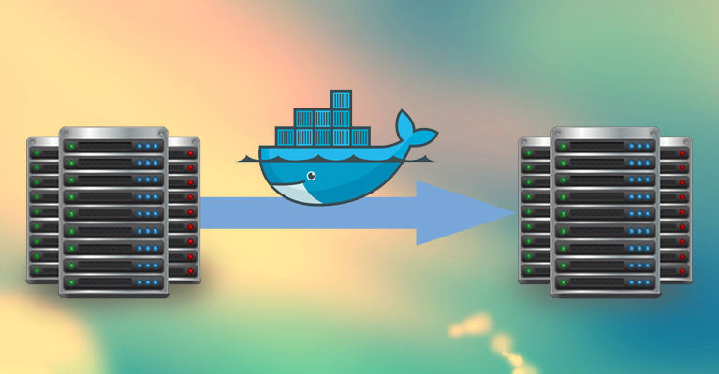
Shipping Container Images
Containers can be Exported and Imported
Via TAR-files
Images can be Saved and Loaded
Via TAR-files

Slide 37
Leveraging Containers on the Oracle workfloor
Container Use Cases for Oracle Professionals

Slide 38
Container Use Cases for Oracle professionals
R&D (aka Play) – try out technology
Quickly, easily, cleanly
Complex, multi-node configurations
Leverage huge number of resources available out in the open
Prepare and Share (running) environments for
Playing, Training, Testing, Beta-testing,
Deploy and Run application on generic cloud infrastructure
Especially ephemeral (stateless) and dynamically scalable
Streamlined CD across Development, Test and Production
Prepare for Cloud (consolidate, lift & shift workloads)
Analysis & What If Scenarios
Clone an environment, spin up, investigate, tear down & quit
Automated Testing
Against rich dataset with minimum set up and tear down
Microservices – implement, deploy and run

Slide 39
Manage Test Data Set for (automated) tests
Build a Container Image with:
Oracle Database
Application Database Objects from DDL
Test Data Set (with all cases and relevant details)
Commit and Tag with (Sprint) Release
Oracle Database
AppTest:R17.49.1
DDL
DML scripts or Export for Test Data

Slide 40
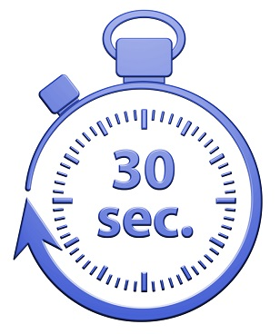
Run (Automated) Test
docker container run
-d -p 1521:1521
-rm AppTest:R17.49.1
Run container image for designated release
with –rm flag
start database
Execute test
No set up, no tear down
Stop container
AppTest:R17.49.1
Oracle Database
Test Data
Application

Slide 41
Run (Automated) Test
Run container image for designated release
with –rm flag
start database
Execute test
No set up, no tear down
Stop container
Next test – or even in parallel
AppTest:R17.49.1

Slide 42
Manage Test Data Set for (automated) tests After a new (Sprint) Release
Run Container for Previous Release
Apply DDL to Upgrade Application
Manage Data Set – test cases to cater for new features
Commit and Tag with new (Sprint) Release label
AppTest:R17.49.1
AppTest:R17.51.1
DDL
R17.51.1
DML scripts or Export for Test Data Updates R17.51.1

Slide 43
Run (Automated) Test using Docker Snapshot (1)
docker container run
-d -p 1521:1521
--name=AppTestR17491 -rm AppTest:R17.49.1
Run container image for designated release
start database
Create Container Checkpoint for running container
AppTest:R17.49.1
Oracle Database
Test Data
Application
docker checkpoint create --checkpoint-dir=${chkptdir}
--leave-running=false AppTestR17491 AppTestR17491CheckPoint
Oracle Database
Test Data
Application
AppTestR17491CheckPoint
Notes:
https://docs.docker.com/engine/reference/commandline/checkpoint_create/

Slide 44

Run (Automated) Test using Docker Snapshot (2)
AppTestR17491CheckPoint
Start Container Checkpoint
0..3 seconds
Execute test
No set up, no tear down
Stop Container
Next test – or even in parallel
Oracle Database
Test Data
Application
Oracle Database
Test Data
Application
docker container start -–checkpoint=AppTestR17491CheckPoint
--checkpoint-dir=${chkptdir}
AppTestR17491
AppTest:R17.49.1
Notes:
https://docs.docker.com/engine/reference/commandline/checkpoint_create/
https://yipee.io/2017/06/saving-and-restoring-container-state-with-criu/

Slide 45
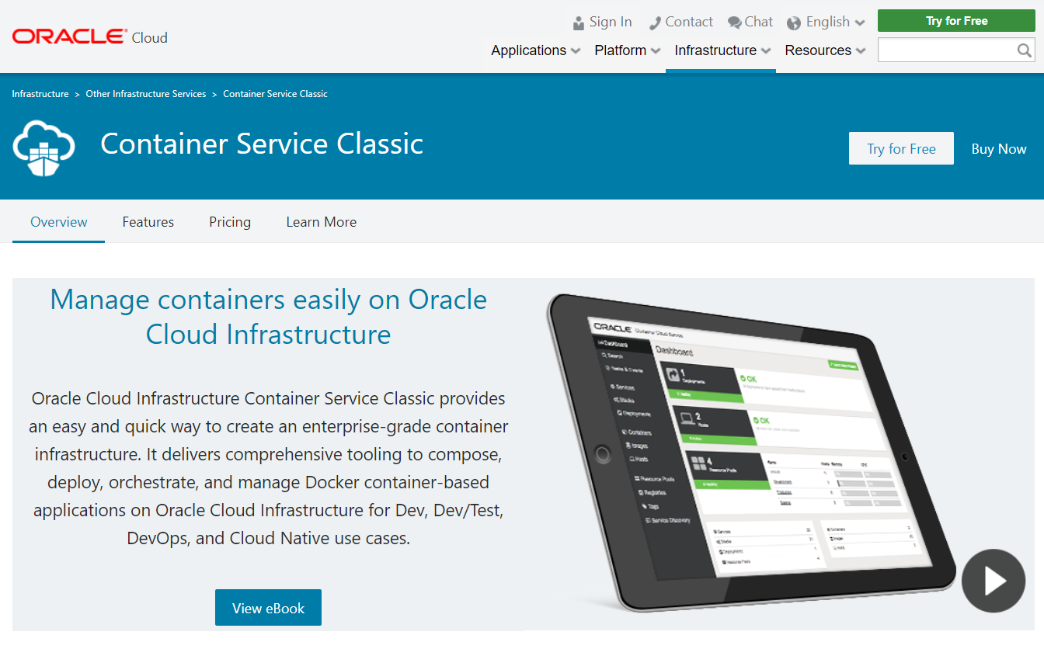
Oracle Container Cloud
Run Docker Containers on Oracle Cloud
Notes:
https://cloud.oracle.com/container-classic

Slide 46
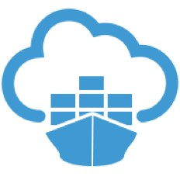
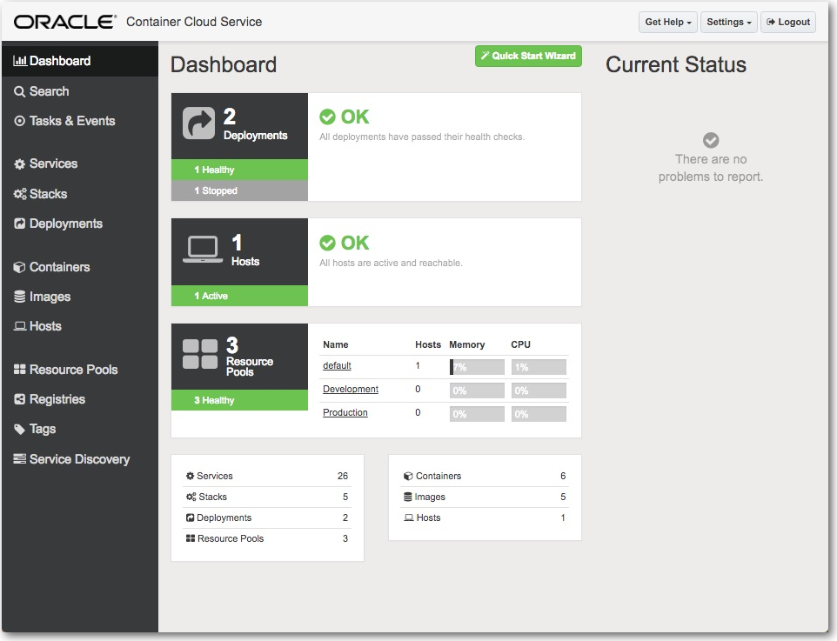
Oracle Container Cloud for Docker Containers
Configure number of worker nodes for the OCC instance
Define resource pools
Assign service (i.e. container image) to resource pool
Specify # instances
Specify image input
Port mapping, environment variable, volume, network
Optionally define stacks
Combinations of services

Slide 47
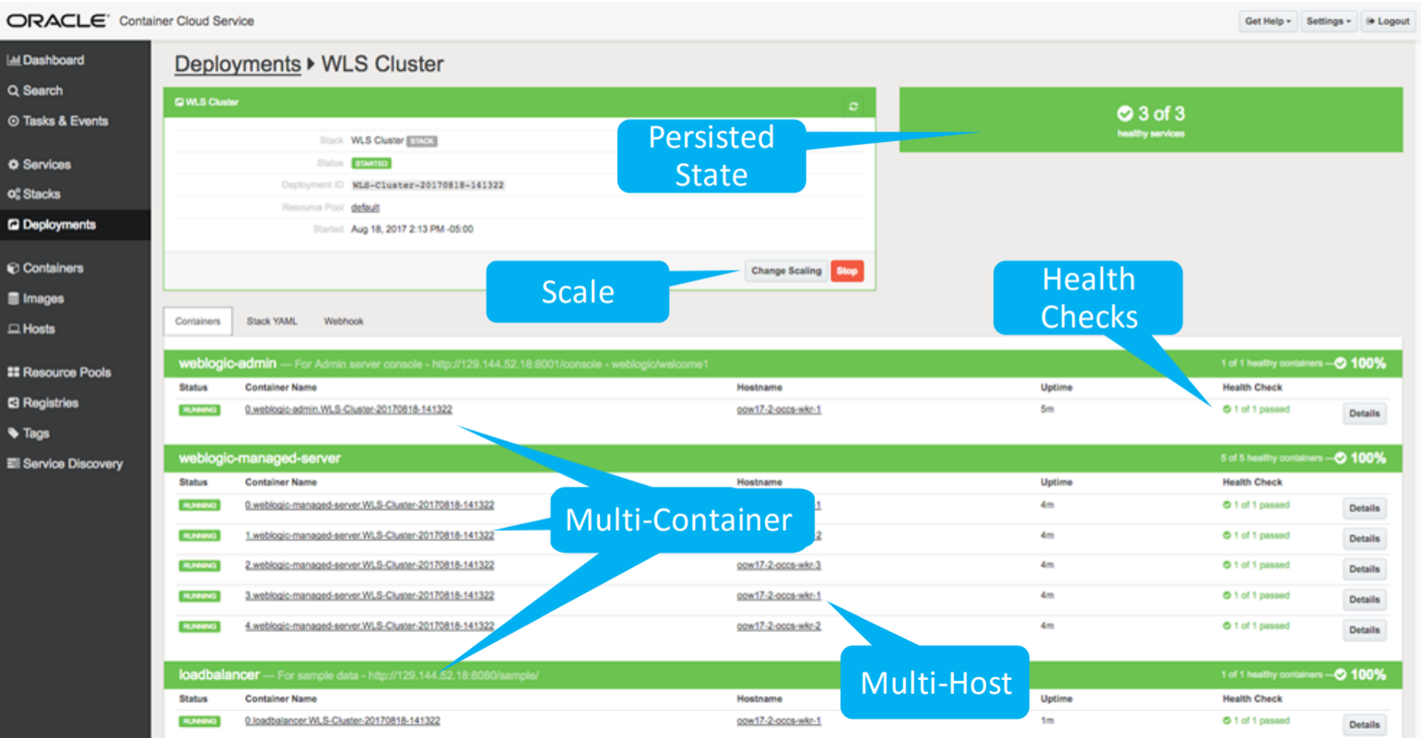
WebLogic on Oracle Container Cloud

Slide 48
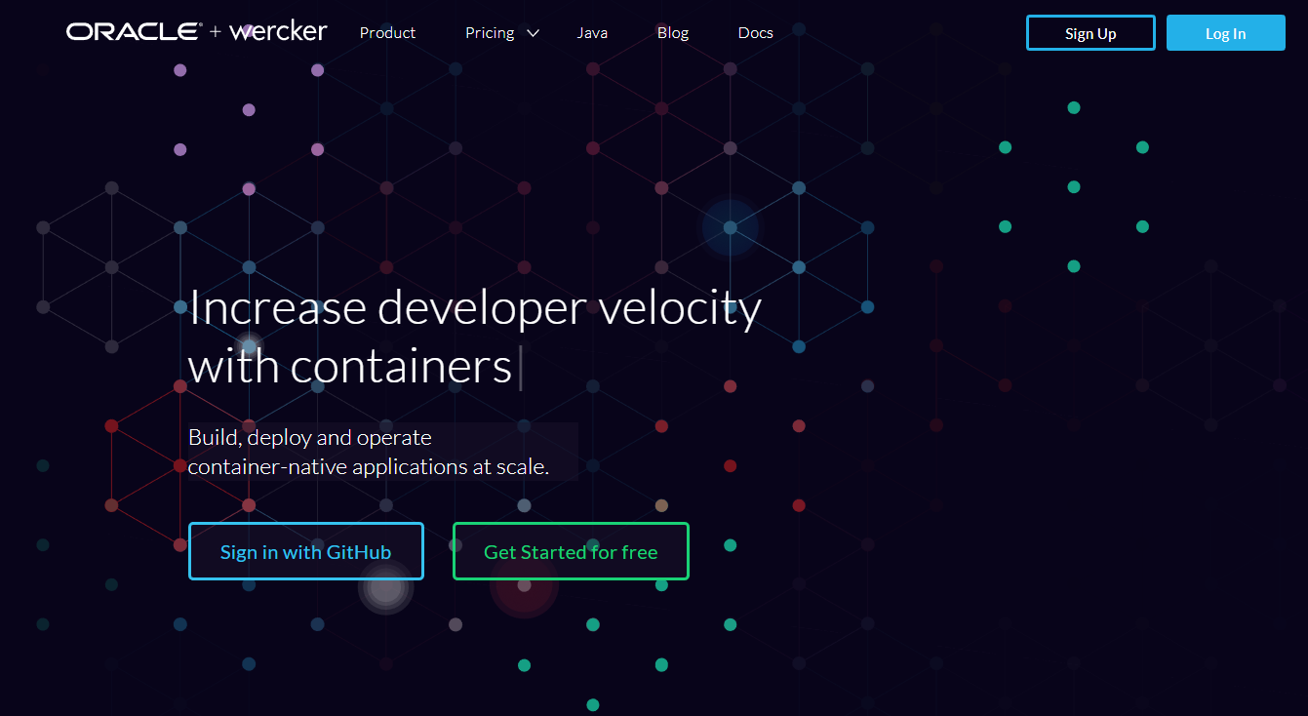
Oracle Wercker
Automating CI/CD Pipeline for Containers

Slide 49
Once upon a time – a container based microservice
http requests
µ

Slide 50
Where is the container running?
Any Docker Host – on premises or cloud based VM - or a Container Cloud Service
For example: Oracle Container Cloud Service
µ

Slide 51
How did the container start running in the runtime?
µ
Through a CI/CD Pipeline
Build process
Take a Basic runtime image – e.g. Linux plus Some Language VM
Add application code
Add runtime agents and tooling
Add platform/runtime configuration
Then Build the Image
Test the Image
Tag and Push Image to Registry
Deploy the image plus applicable configuration to a specific destination container runtime environment
The CI/CD Process is managed manually or triggered by development event

Slide 52
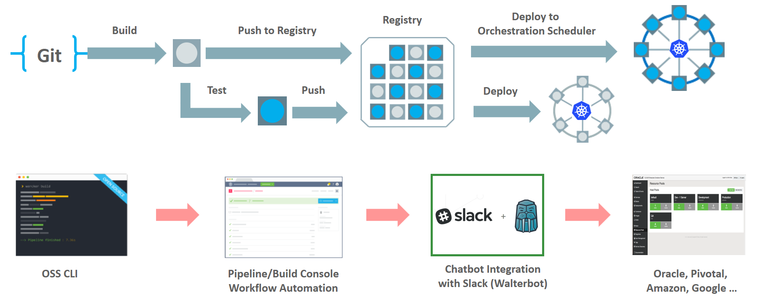
Wercker: Build, Test, Push and Deploy Pipelines for Containers
µ
µ
µ

Slide 53
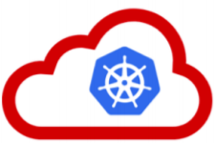
Kubernetes and Oracle Kubernes Engine Cloud
The application and microservices runtime platform of tomorrow
Notes:
https://cloud.oracle.com/container-classic

Slide 54
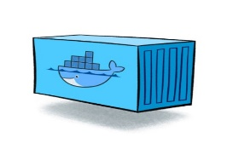
Containers
As vehicle for:
Encapsulate
Build
Share & Ship
Automated Tests
Deploy
Run
Scale
Relocate
Standardize

Slide 55
Looking for a runtime platform for
Compute Node
Notes:
Deploy and Run (Docker Containers)
Distributed infrastructure (scalable and available)
Hide infrastructure from DevOps teams
Auto-healing
Elastic Scale
Wire up the micros – connect dynamically (service discovery)
Load Balance
Provide Persistent storage
Rolling Upgrade
Configuration & Secret Management
Secure

Slide 56
Looking for a runtime platform for
Compute Node
Compute Node
Compute Node
Notes:
Deploy and Run (Docker Containers)
Distributed infrastructure (scalable and available)
Hide infrastructure from DevOps teams
Auto-healing
Elastic Scale
Wire up the micros – connect dynamically (service discovery)
Load Balance
Provide Persistent storage
Rolling Upgrade
Configuration & Secret Management
Secure

Slide 57
Looking for a runtime platform for
Compute Node
Compute Node
Compute Node
Notes:
Deploy and Run (Docker Containers)
Distributed infrastructure (scalable and available)
Hide infrastructure from DevOps teams
Auto-healing
Elastic Scale
Wire up the micros – connect dynamically (service discovery)
Load Balance
Provide Persistent storage
Rolling Upgrade
Configuration & Secret Management
Secure

Slide 58
Looking for a runtime platform for
Compute Node
Compute Node
Compute Node

Slide 59
Looking for a runtime platform for
Compute Node
Compute Node
Compute Node

Slide 60
Looking for a runtime platform for
Compute Node
Compute Node
Compute Node
Cloud Storage
SAN

Slide 61
Looking for a runtime platform for
Configuration Map
Configuration Map
Compute Node
Compute Node
Compute Node
Cloud Storage
SAN

Slide 62

Looking for a runtime platform for
Compute Node
Compute Node
Compute Node

Slide 63
Looking for a runtime platform for
Compute Node
Compute Node
Compute Node
Compute Node
Compute Node

Slide 64
Looking for a runtime platform for
Compute Node
Compute Node
Compute Node

Slide 65
Looking for a runtime platform for
v2
v2
v2
Compute Node
v2
v2
Compute Node
Compute Node

Slide 66
Kubernetes (“pilot, steersman”)

Slide 67


Slide 68


Slide 69


Slide 70


Slide 71


Oracle Docker Build Files GitHub Repo
Building Docker containers with Oracle platform
Notes:
https://github.com/oracle/docker-images

Slide 72

Example of Docker File
Build a Docker Container with Java 8 Runtime

Slide 73

Build Docker Container for Oracle Database 12.2.0.1 Enterprise Edition
Download database installation binaries before building the container

Slide 74

Why run Oracle Database on Docker?
Because we can…
Automated testing
Clone environments
Similar to PDB cloning
Quick provisioning of new environments
R&D
Production workloads?
Automated Ops/DBA => Autonomous Database (?)

Slide 75

Running WebLogic Server in Docker Containers - when and why?
Notes:
WLS Roadmap – CON6474 Oracle OpenWorld 2017

Slide 76

Notes:
Migrate WebLogic to Containers – OOW2017

Slide 77

Oracle Container Registry
Running containers from prebuilt images
Notes:
https://container-registry.oracle.com

Slide 78


Slide 79




Slide 80

Run Oracle Database from official Container Image
docker run -d -it –-name ORA12201_1 –P container-registry.oracle.com/database/enterprise:12.2.0.1

Slide 81


Run Oracle Database – from a container image

Slide 82


Slide 83


Oracle Container Registry for Your Images
After build and before run – container images need to be stored
Secure (because runtime artefacts)
Accessible (& low latency) to deployment engine and container runtime
Scalable and Smart (no duplicate images and image layers)

Slide 84

Oracle Cloud Infrastructure – Container Registry

Slide 85


Going forward – what should be your moves?
Start playing.
https://www.katacoda.com/courses/docker
Notes:
https://www.katacoda.com/courses/docker

Slide 86
Going forward – what should be your moves?
Learn about Docker
Brush up on your Linux skills
Install Docker and run some images
Experiment with Port, Link, Volume, Environment Variables
Create your own build file, build a container and commit as image
Push your own image to a Docker Registry
Using a trial on Oracle Cloud – run a container from your image on the Container Cloud or on the OCI Kubernetes Engine Cloud
Run containers based on the official Oracle Docker build files on GitHub
Run containers based on the official Oracle Docker images on Oracle Container Registry
Learn about Kubernetes (KataKoda is an excellent environment)
Experiment with Kubernetes locally (on minikube)
And on Oracle Kubernetes Engine Cloud

Slide 87

Summary
Docker is a great technology to
Run
Share, Ship & Deliver
Build
encapsulated environments with run time platform and application
Containers are likely the core run time unit to manage: deploy, configure, scale, monitor, interconnect, secure
Kubernetes is the de facto distributed container management platform for cloud and on premises
Oracle does Docker and Kubernetes in anger

Slide 88




Thank you!
Blog: technology.amis.nl
Email: lucas.jellema@amis.nl
: @lucasjellema
: lucas-jellema
: www.amis.nl, info@amis.nl

